Slide 1
𝗪𝗲𝗯 𝗗𝗲𝘃𝗲𝗹𝗼𝗽𝗺𝗲𝗻𝘁
𝐒𝐭𝐮𝐝𝐞𝐧𝐭𝐬 𝐍𝐚𝐦𝐞 :𝐓. 𝐕𝐢𝐬𝐡𝐚𝐥𝐢𝐧𝐢
𝐑𝐞𝐠𝐢𝐬𝐭𝐞𝐫 𝐀𝐧𝐝 𝐍𝐌𝐈𝐃: 𝟐𝟒𝟏𝟑𝟏𝟏𝟑𝟏𝟖𝟎𝟐𝟓𝟐𝟐𝟎𝟐𝟎/𝐚𝐬𝐧𝐦𝟏𝟏𝟑𝟐𝟒𝟏𝟑𝟏𝟖𝟎𝟐𝟓𝟐𝟐𝟐𝟎
𝐃𝐞𝐩𝐚𝐫𝐭𝐦𝐞𝐧𝐭:𝐁𝐬𝐜. 𝐂𝐨𝐦𝐩𝐮𝐭𝐞𝐫 𝐬𝐜𝐢𝐞𝐧𝐜𝐞
𝐂𝐨𝐥𝐥𝐞𝐠𝐞: 𝟏𝟏-𝟑 𝐕𝐚𝐥𝐥𝐚𝐥𝐚𝐫 𝐀𝐫𝐭𝐬 𝐀𝐧𝐝 𝐒𝐜𝐢𝐞𝐧𝐜𝐞 𝐜𝐨𝐥𝐥𝐞𝐠𝐞,
𝐀𝐧𝐧𝐚𝐦𝐚𝐥𝐚𝐢 𝐔𝐧𝐢𝐯𝐞𝐫𝐬𝐢𝐭𝐲

Slide 2
𝐏𝐫𝐨𝐣𝐞𝐜𝐭 𝐓𝐢𝐭𝐥𝐞
𝐖𝐄𝐁 𝐃𝐄𝐕𝐄𝐋𝐎𝐄𝐍𝐓

Slide 3
Agenda
Introduction
Importance of web development
Types of web development
Web development tools
Web development process
Modern trends
Challenge in web development
Carreer opportunities
Conclusion

Slide 4
Introduction
What is Digital Web Development? Designing and building websites & applications Combination of frontend, backend, and databases

Slide 5
Importance of web development
Creates online presence for businesses Enhances user experience Drives digital marketing & e-commerce Supports global communication

Slide 6
Types of web development
Frontend Development → UI/UX, HTML, CSS, JavaScript Backend Development → Server, databases, APIs Full-stack Development → Both frontend & backend CMS Development

Slide 7
Web development tools
Planning & Research 2. UI/UX Design (Wireframes, Prototypes) 3. Development (Frontend & Backend coding) 4. Testing & Debugging 5. Deployment (Hosting & Domain) 6. Maintenance

Slide 8
Modern Trends
Responsive Web Design Progressive Web Apps (PWA) Artificial Intelligence Integration Web 3.0 & Blockchain Cloud Hosting & Serverless Architecture

Slide 9
Challengs in web development
Security and Data privacy
Browser and device compatibility
Performance optimization
Keeping up with new technologies

Slide 10
Career opportunities
Web designer
Frontend developer
Backend developer
Full stack developer
Ui/Ux specialist

Slide 11
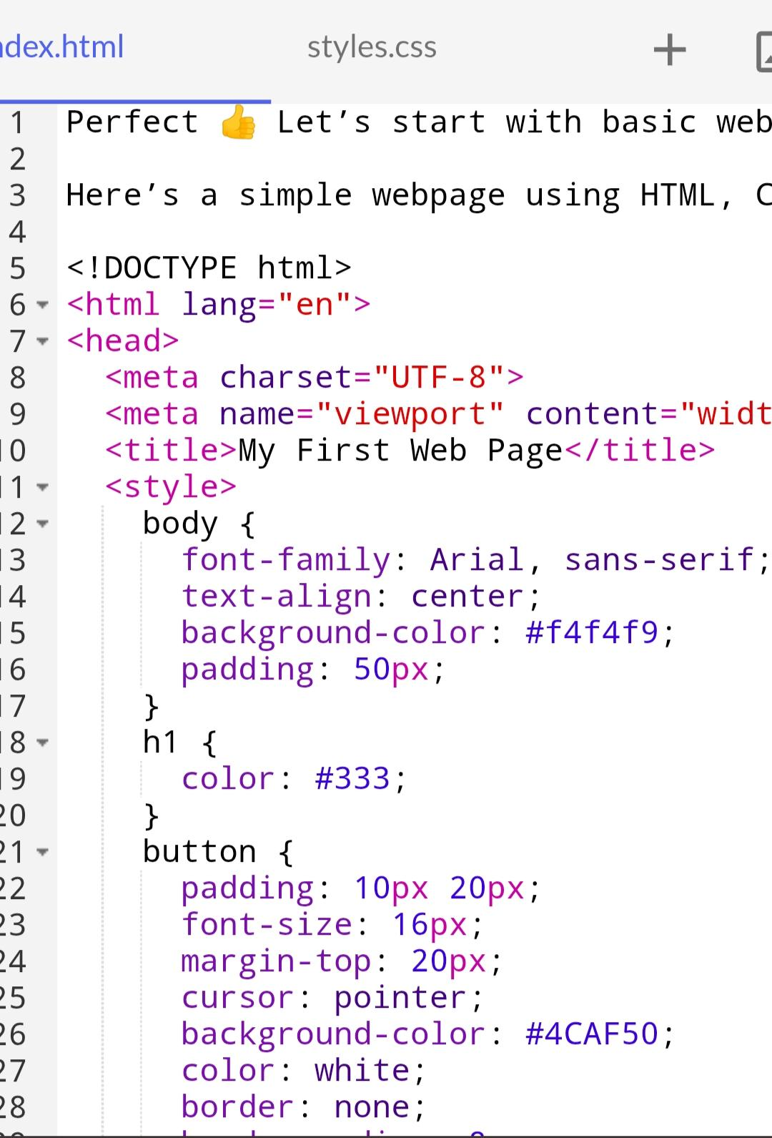

Slide 12


Slide 13
Conclusion
Web development is essential in the digital era
Continuous learing of tools and trends
Innovation+creativity=better user experience

